Slide 1
Gesture-Based Human-Computer Interaction
Mentor: Dr. M. Jayalakshmi

Slide 2
Agenda
Introduction
Objective
Benefits to community people
Problem statement
Literature survey
Software components
Algorithm
Real time demonstration
Work done
Results
Conclusion
References

Slide 3
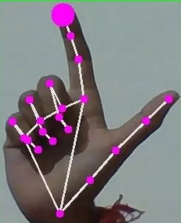
Introduction
Human-computer interaction (HCI) is the study of how individuals interact with computers and other technologies.
One of the most recognizable and common input devices in Human-Computer Interaction (HCI) is the computer mouse.
Making it simpler for users to move around virtual spaces and work with graphical user interfaces.
In this We are trying to implement virtual mouse in different ways revolutions in now a days.

Slide 4
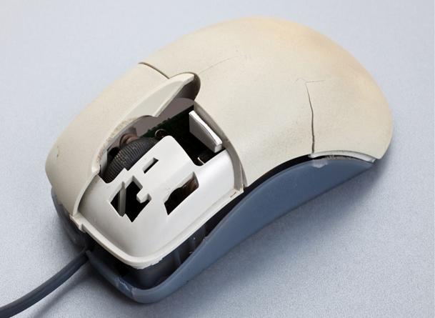
Objective
Develop an accurate and responsive hand-controlled mouse interface using computer vision to provide users with a natural, hands-free interaction method that enhances accessibility, productivity, and creativity in digital environments in a different ways.

Slide 5
Benefits for community people
Accessibility: For people with physical limitations or restricted flexibility, virtual mouse solutions offer an accessible way to communicate with computers. It promotes greater independence and inclusion by enabling people to operate and navigate digital interfaces without the need for conventional input devices.
Health and Ergonomics: Virtual mouse systems reduce the physical strain associated with extended computer use. Users can control their devices comfortably through hand gestures and eye movements, minimizing the risk of repetitive strain injuries and ergonomic discomfort.
Gesture-Based Convenience: Hand gestures enable users to interact with computers in an intuitive and natural manner. This can simplify tasks such as clicking, volume increasing and decreasing through applications, making computing more user-friendly and efficient.
Eye-Tracking Efficiency: Eye-tracking mouse enhances efficiency by allowing users to control the cursor's movement with their look. This feature can be particularly advantageous in scenarios where precise pointing or quick navigation is essential, such as design work or data analysis.

Slide 6
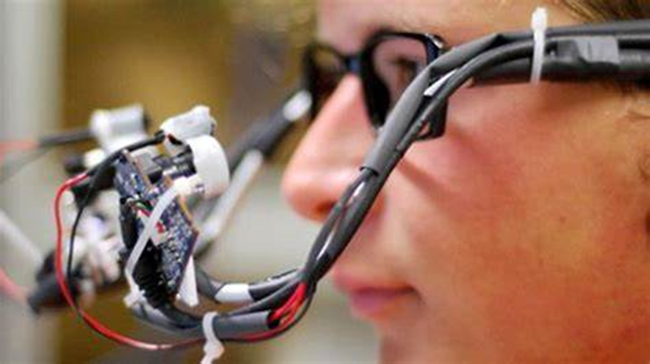
Problem statement
"Develop a graphical user interface (GUI) application that uses computer vision techniques to enable various interactions with the computer, including hand gesture-based volume control, virtual mouse control using hand movements, eye-controlled mouse movement and clicking, and capturing and displaying images from the webcam."

Slide 7
Literature survey
AUTHOR | TECHNIQUES USED | OBSERVATION | LIMITATION
H.A.Musthafa et al | Eye tracking , Feature extraction | The authors also note that their framework has several advantages over traditional input methods, such as mouse and keyboard | The authors acknowledge limitations in their framework, including reliance on precise eye-tracking technology and susceptibility to errors from head movements and lighting variations.
Andreas Butz et al | it analyzed the performance and efficiency of these two input methods in terms of accuracy, speed, and user preferences | The paper compared the effectiveness of mouse and touch input for desktop computing tasks, and found that mouse input was more efficient | Limited sample size , Limited duration
M.A.Rhman et al | CNN , gesture recognition | Training accuracy is very low | It differs for person to person

Slide 8
Literature survey
AUTHOR | TECHNIQUES USED | OBSERVATION | LIMITATION
A.R.Vilela et al | Skin color segmentation , Template matching | The system was able to recognize six hand gestures with an average accuracy of 92%. | Sensitivity to lighting condition , limited hand gestures
S.K.Singh et al | CNN architecture, cursor movement | The system achieved an accuracy of 97.7% on the test set. | Dataset limitations , limited testing
Jacob o et al | Adaptive filters , Dwell time | The paper highlights the importance of adapting input devices to the specific needs of these users to improve their computer interaction experience | They did not consider other assistive technologies or alternative input devices that may be more suitable for these users

Slide 9
Software components
Graphical User Interface (GUI)
Computer Vision Modules
Automation and Interaction
Webcam Interface

Slide 10
Software Requirements
Python version:- 10.4.3
Packages:-
1.Opencv
2.mediapipe
3.Pyautogui
4. Tkinter
5.pillow

Slide 11
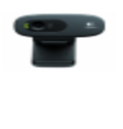

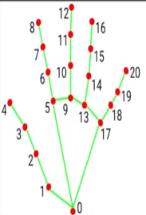
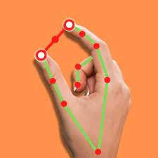
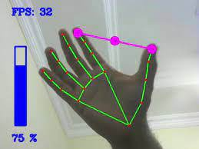
Methodology:-
start
Open cv
Converts one colour space to another
(RGB->BGR)
Hands
Land marks are detected on hand
Pyauto GUI
Volume increase
Volume decrease
Program close
End

Slide 12

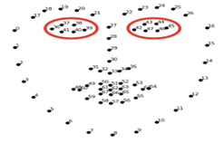
Methodology:-
start
start
Open cv
Mesh warp algorithm
Face mesh
Coverts B&W->RGB
Canny edge detection algorithm
Pyauto GUI
click
move
Program close
End

Slide 13
Real time demonstration
This project highlights the real-time nature of the project, showcasing various HCI innovations such as virtual mouse control, volume adjustment through hand gestures, eye-controlled mouse functionality, and real-time photo capture. It conveys the dynamic and interactive nature of your code.

Slide 14
Work done
Hand Gesture Volume Control
If the distance increases, it triggers a "volume up" action, and if it decreases, it triggers a "volume down" action.
1
Virtual Mouse Control
It captures hand landmarks and allows users to move the mouse cursor on the screen by moving their hand.
2
Eye-Controlled Mouse
It enables eye-controlled mouse movement by utilizing facial landmarks and eye-tracking technology.
3
Screenshot Capture
This button captures a photo from the webcam feed after 50 frames and saves it as "captured_photo.jpg.“
The captured image is then displayed using the Pillow (PIL) library.
4

Slide 15
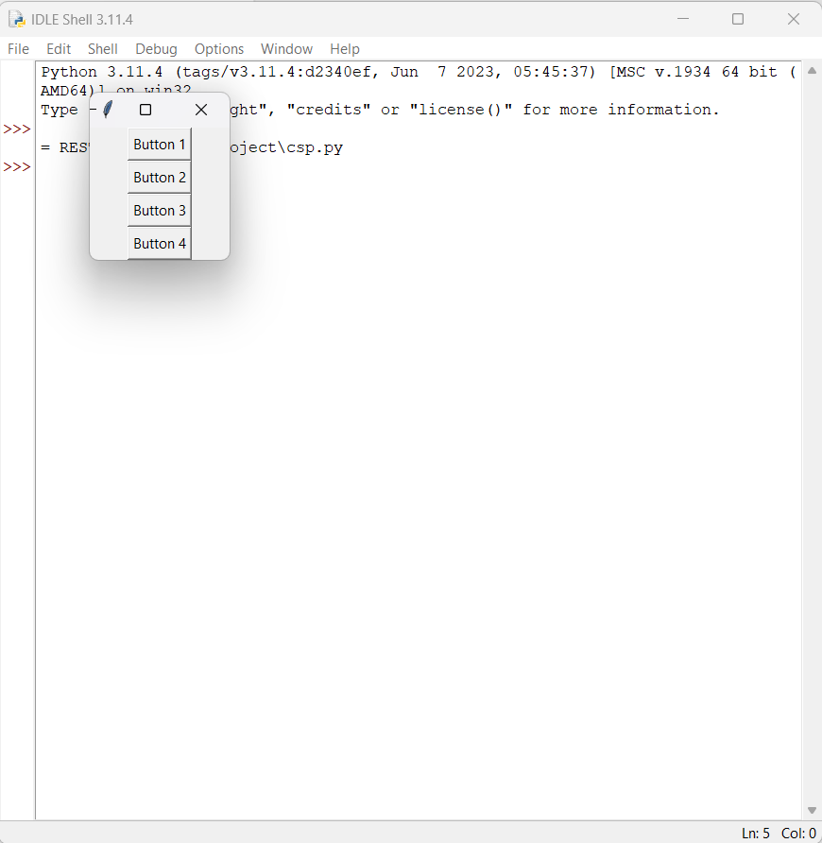
Result

Slide 16
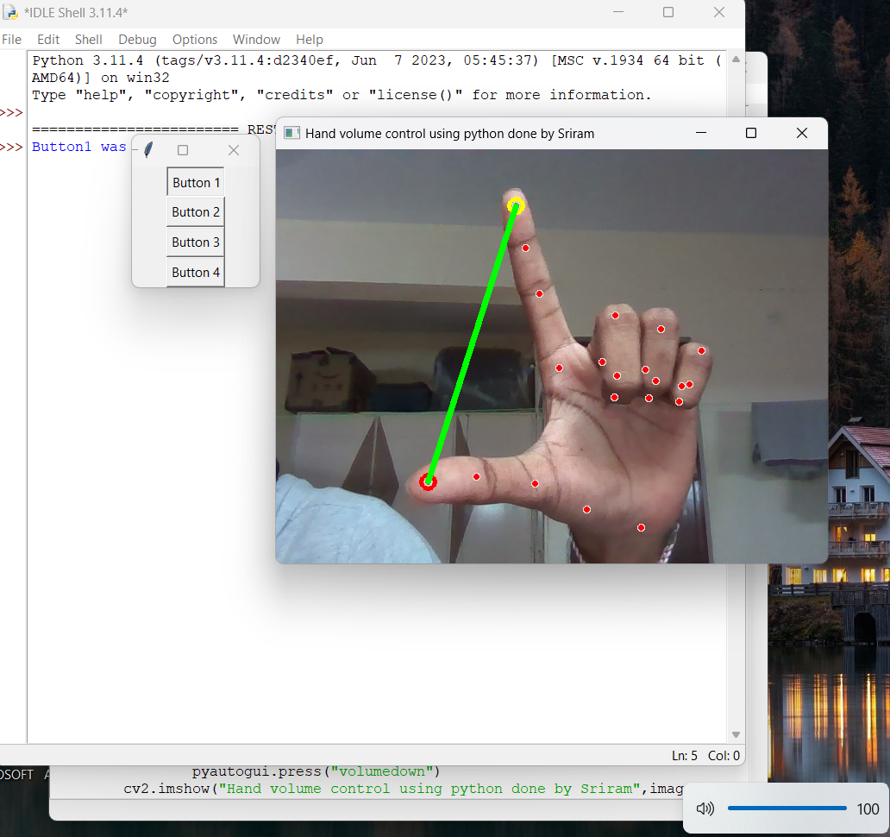
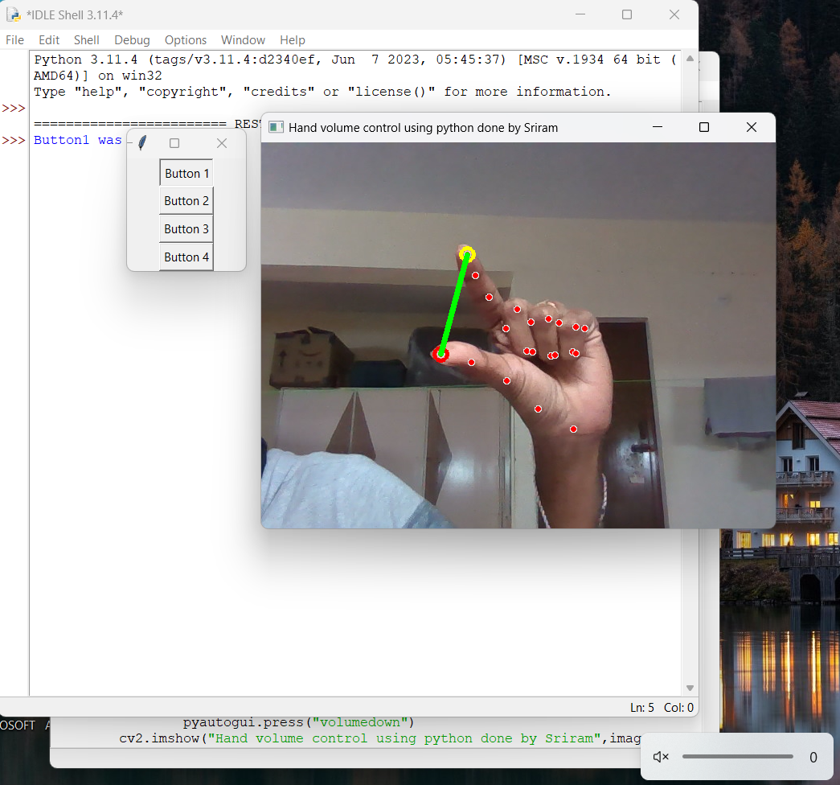
Button 1 results:
Increases distance triggers ‘volume up’
Decreases distance triggers ‘volume down’

Slide 17
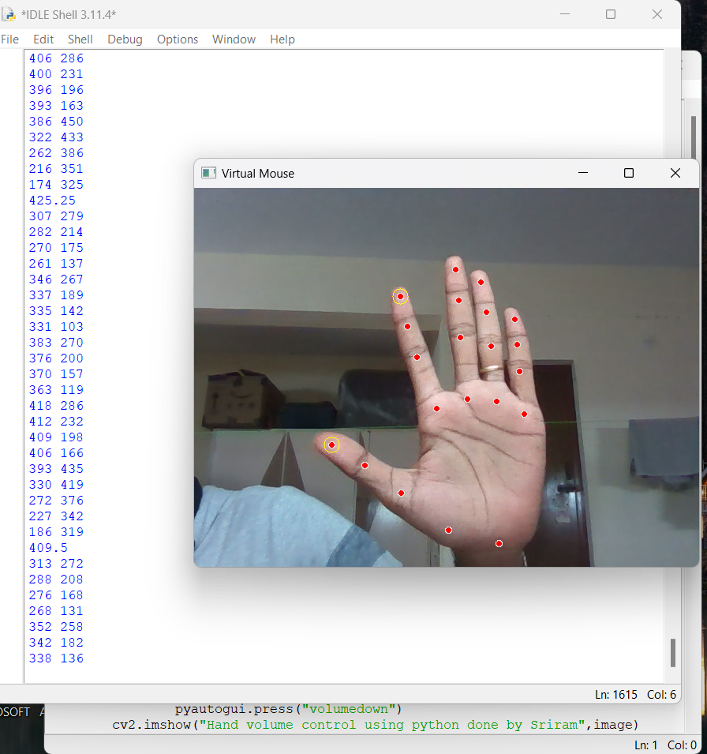
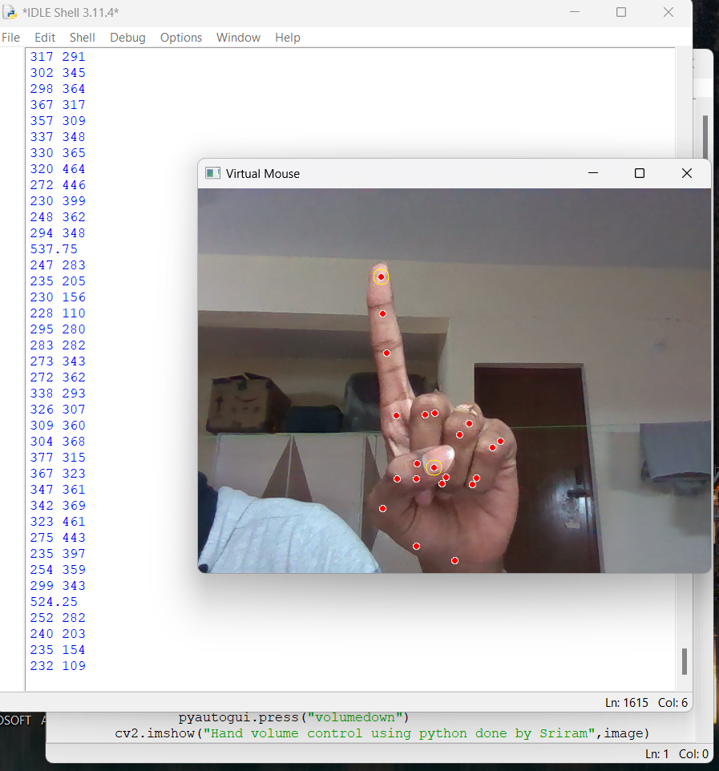
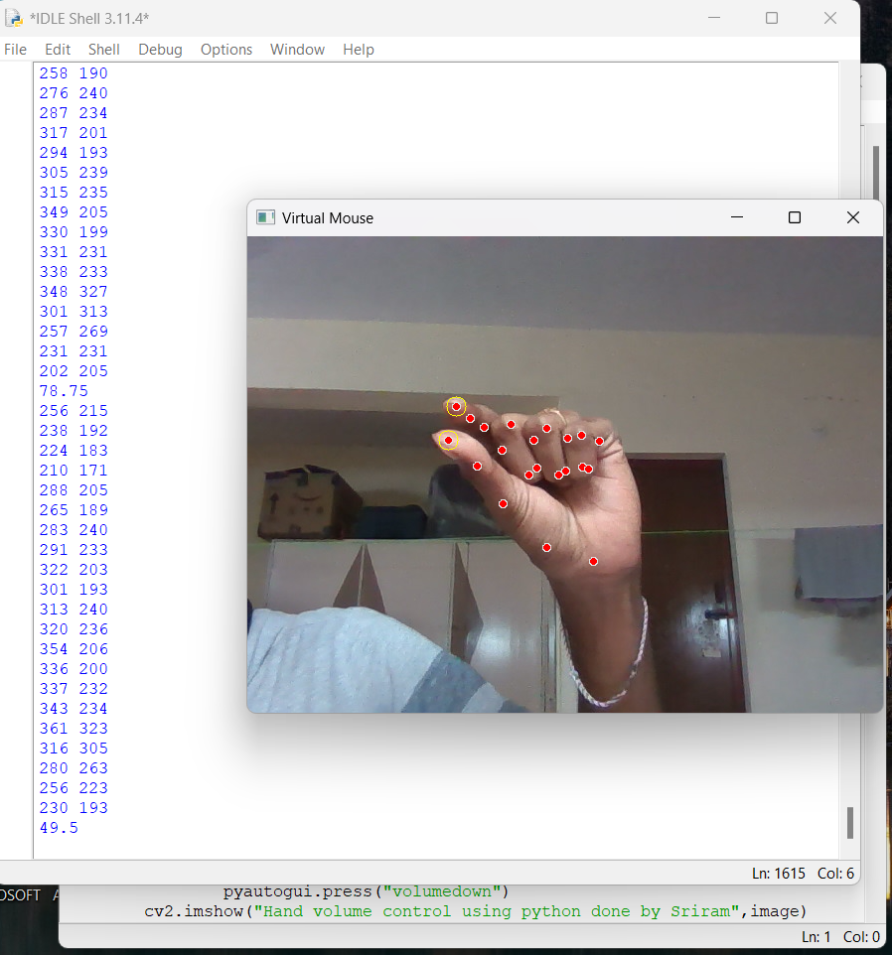
Button 2 results:
Sensing the fingertips
moving action with index finger
clicking action

Slide 18
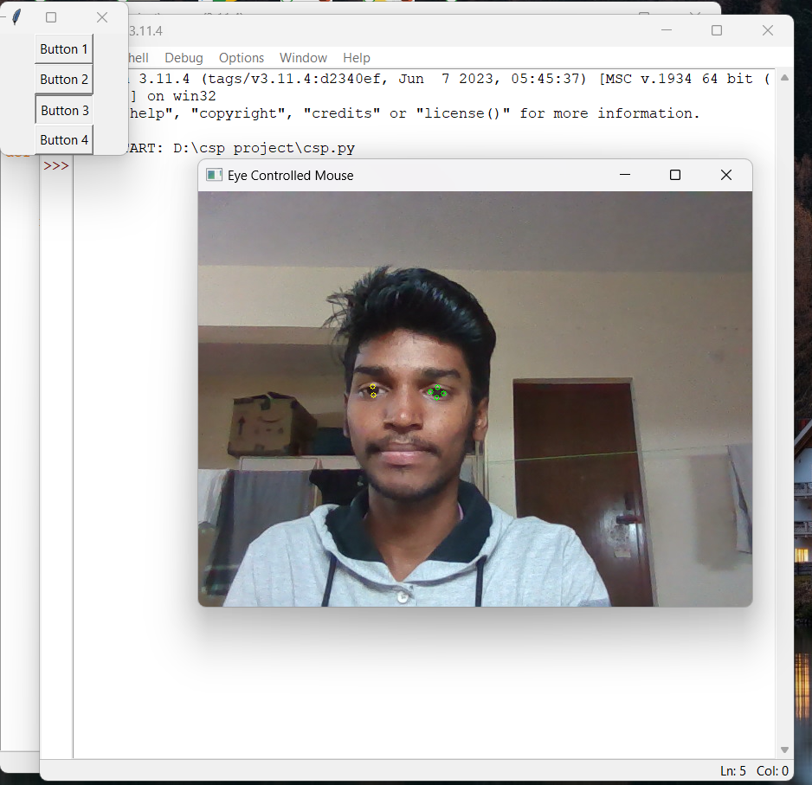
Button 3 results:
we observed that when this button is pressed, the webcam tracks the user's eye motions and uses landmarks to direct the mouse pointer. The system moves the cursor based on the position of the eyes, and it uses blink detection to act out mouse clicks. This offers a hands-free method of employing eye motions to interact with the computer. The face's landmarks and the cursor position can be seen on the processed video feed.
Landmarks recognition of eyes

Slide 19
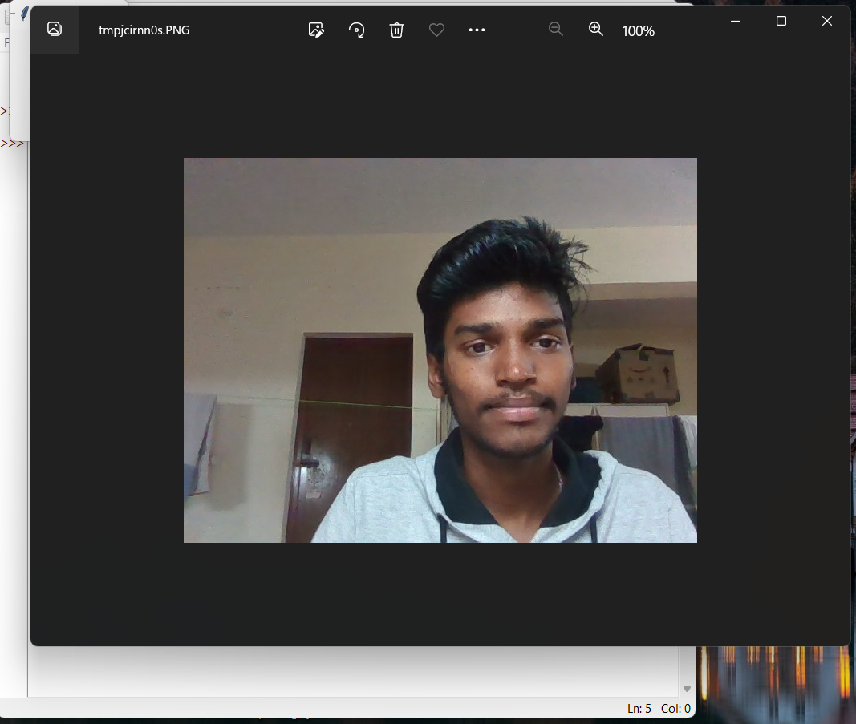
Button 4 results:
we observed that when this button is clicked, a webcam image is taken and saved as "captured_photo.jpg". The captured image is then opened using the PIL library. This feature offers a straightforward method for utilizing the application to take and view images.
Capturing image and display in our system

Slide 20
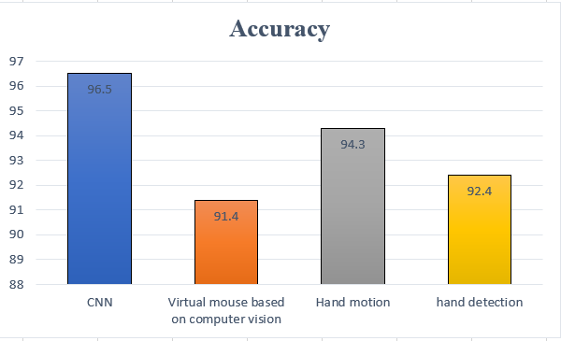
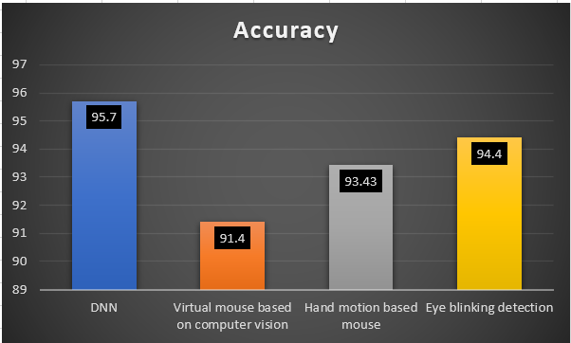
Accuracy:
Accuracy graph for hand controlled mouse
Accuracy graph for eye controlled mouse

Slide 21
conclusion
In conclusion, the Multi-model Human-Computer Interaction System effectively illustrates the possibilities of using hand gestures and eye movements as a natural and intuitive way for computer systems to receive input. The system increases accessibility and user experience greatly by allowing people to control and interact with computers through gestures, thus providing an alternative to traditional input devices. It also has the potential to empower people with motor disabilities by giving them more independence and access to digital resources.

Slide 22
References
1. Mukthineni, V., Mukthineni, R., Sharma, O., & Narayanan, S. J. (2020). Face authenticated hand gesture based human computer interaction for desktops. Cybernetics and Information Technologies, 20(4), 74-89
2. Vuletic, T., Duffy, A., Hay, L., McTeague, C., Campbell, G., & Grealy, M. (2019). Systematic literature review of hand gestures used in human computer interaction interfaces. International Journal of Human-Computer Studies, 129, 74-94.
3. Mhetar, A., Sriroop, B. K., Kavya, A. G. S., Nayak, R., Javali, R., & Suma, K. V. (2014, November). Virtual mouse. In International Conference on Circuits, Communication, Control and Computing (pp. 69-72). IEEE
4. D. C. Engelbart and W. K. English, "The Computer Mouse: A Device to Control the Onscreen Cursor," in AFIPS '68 (Fall, part I): Proceedings of the December 9-11, 1968, fall joint computer conference, 1968, pp. 1-4, doi: 10.1145/1468075.1468082
5. Bharath, M. R. R. (2022). Controlling Mouse and Virtual Keyboard using Eye-Tracking by Computer Vision. Journal of Algebraic Statistics, 13(3), 3354-3368

Slide 23
Thank you
S DURGA SAI SRIRAM - 99210041287
T PARDHA SARADHI – 99210041493
SMD RAHIL AZAM – 9921004705
SHAIK FAZIL - 9921004652

